Slide 1
Microsoft Project 2007
Working with Resources

Slide 2

Objectives
Setup Resources
  Types of resources
  Manage Availability
  Specify resource pay rates.
  Adjust the work timings for a resource
Assign Resources
  Assign work resources to a task.
  Add additional resources to a task.
  Assign material and cost resources to a task.

Slide 3
Types of Resources
Work
  People/Role
    Individuals – Ram & Shyam
    Job titles (Role) – Project Manager, Developer, Tester
  Equipment
    Resources other than people that are required to complete a task - Machinery, computer etc
Material
  Material resources are consumable supplies which are used while accomplishing a task
  Used mainly to track the rate of their consumption and associated cost
  Cement, Diesel, CDs, Tapes etc.
Cost Resources
  Used to associate a particular type of cost with one or more tasks.
  The value of the cost resource does not depend on the amount of work done on a task or on the duration of a task
  Every incidence of cost resource assigned to different tasks can have differing cost value
  Travel, entertainment, training etc.

Slide 4
Manage Availability
Individual Resources
  Max availability – 100%
  Specify percentage availability for part time resources
Role that represents a category of interchangeable people who do the same work
  Max Availability – can be more than 100%
  3 developers in the project will make developers availability as 300%
Equipment
  Can work round the clock (24 hours calendar)
  Max Availability – can be more or less than 100%
Material resources
  Add number of units of material resource that are available to consume by specific task at the time of assigning the resource
Specifying cost resources
  Specify cost value of resource while assigning cost resource for each instance

Slide 5
Pay rates (Standard Rates)
Cost of Work Resource - Calculated on an hourly basis
Cost of Material Resource - Calculated on the basis of per unit of consumption and is a fixed amount
Cost of Cost Resource - There is no standard rate value, the cost for each assignment must be specified in the project plan
Why specifying standard rates is important
  To calculate the total cost of a resource across the life cycle of the project.
  You can also manage the total cost of the project based on task duration and resource estimates.
  Helps you determine the amount of funds that you can allocate to a particular type of expense
  Help allocating budge to the project
  Help you managing cost of your project
  Also important for EVM calculations

Slide 6
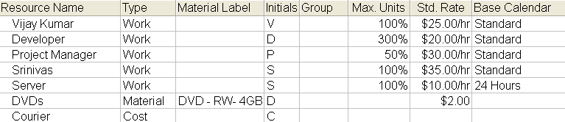
Add resources
Switch to Resource Sheet View
Create list of resources as below

Slide 7
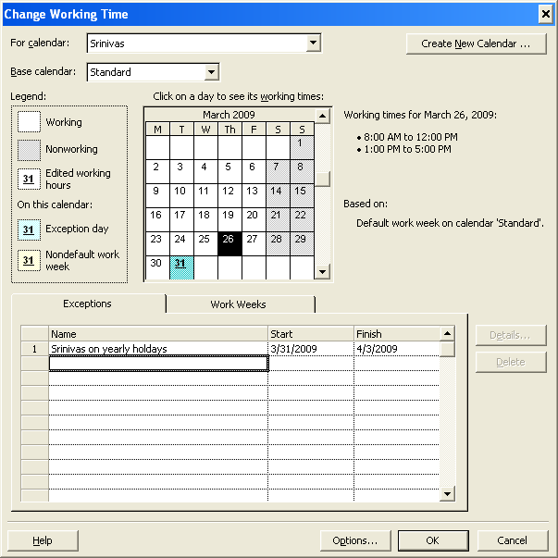
Adjusting Work Timings for the Resources - Exception
Switch to Resource Sheet View
Go to Tools → Change Working Time...
Select the resource in “For Calendar” drop down
Click on exception tab
Enter the name of the exception, start date and end date
Project 2007 will make this duration as nonworking and will show these days as exception days

Slide 8
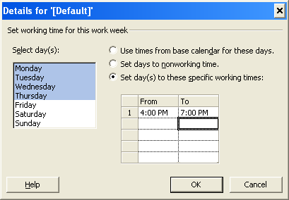
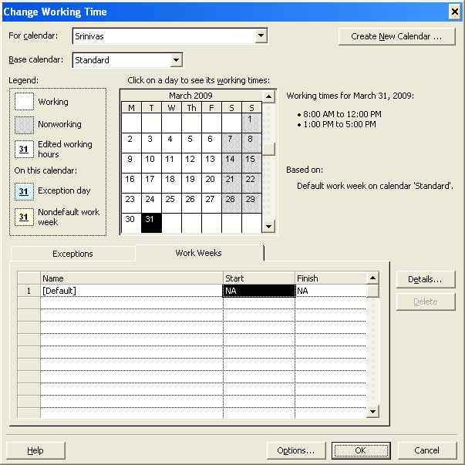
Adjusting Work Timings for the Resources - Regular
Switch to Resource Sheet View
Go to Tools → Change Working Time...
Select the resource in “For Calendar” drop down
Click on Work Weeks tab
Select “[Default]” and click “Details...” button
In “Details for ‘[Default]’” dialog box, Select days/days and change the time as required
Project 2007 will make this duration as nonworking and will show these days as exception days

Slide 9

Exercise: Adjusting Work Timings for a Resource
Exercise 1
  Create an exception for Vijay Kumar to attend a three days training
Exercise 2
  Change the normal working hours for Project Manager as follows
    Monday to Thursday – 3pm to 8pm
    Friday - holiday

Slide 10
Question
Segregate in Work, Material and Cost resources
  Entertainment
  Hourly rates
  Placeholder names
  Printer cartridges
  Travel
  Network printer
  Electrician
  Video Tapes
  Training
  Paper

Slide 11
Question
Segregate in Work, Material and Cost resources
  Entertainment - Cost
  Hourly rates - Work
  Placeholder names - Work
  Printer cartridges - Material
  Travel - Cost
  Network printer - Work
  Electrician - Work
  Video Tapes - Material
  Training - Cost
  Paper - Material

Slide 12
Revisit Objectives
Setup Resources
  Types of resources
  Manage Availability
  Specify resource pay rates.
  Adjust the work timings for a resource
Assign Resources
  Assign work resources to a task.
  Add multiple resources to a task.
  Assign material and cost resources to a task.

Slide 13
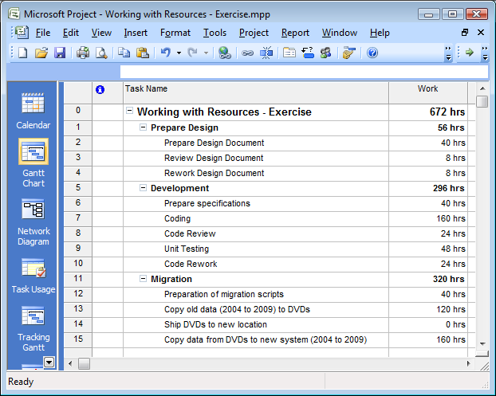
Assigning Resources to Tasks
Let’s create a tasks list for assigning resource

Slide 14
Assigning Work Resources to a Task
Change the view to Gantt Chart.
Assign a work resource,
  Click Prepare Design Document
  Click Tool→Assign Resources. You can also click the Assign Resources button on the Standard toolbar
  in the Resource Name column, scroll down, click on Vijay Kumar, and then click Assign.
Assign multiple work resources to a task,
  Click Review Design Document.
  In the Assign Resources dialog box, click Project Manager, hold down the CTRL key, scroll down, click Srinivas, and then click Assign.

Slide 15
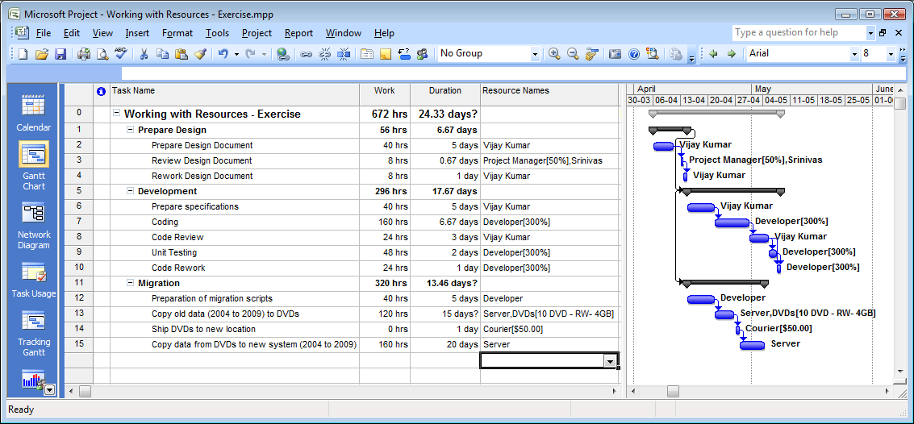
Assigning Work/Material/Cost Resources to a Task

Slide 16

Assign Work/Material and Cost Resources to a Task
Assign Work Resources to a Task (Allocating more than 100%)
  Click Coding
  Click Developer in the Assign Resources dialog box.
  Click on 100% in Units column and make it 300%. Then click Assign
Assign Material Resources to a Task
  Click Copy old data (2004 to 2009) to DVDs
  Click DVDs in the Assign Resources dialog box, and then click in the Units column. Type 10 and then press ENTER.
Assign Cost Resources to a Task
  Click Ship DVDs to new location
  Click Courier in the Assign Resources dialog box, and then click the Cost column. Type 50 and then press ENTER.
  To close the Assign Resources dialog box, click Close.

Slide 17
Questions
You are a Project Manager in a company that produces paper boxes. You have 10 people in your team and machines that produces 1000 paper boxes every week. You have got an order for supplying 5000 boxes and they must be delivered in two weeks. Which of the following action you will take to meet your targets?
Select the one best answer
  Ask resources to put extra hours each day
  Increase the number of resources
  Request to extend the deadline
  ✓

Slide 18
Revisit Objectives
Setup Resources
  Types of resources
  Manage Availability
  Specify resource pay rates.
  Adjust the work timings for a resource
Assign Resources
  Assign work resources to a task.
  Add multiple resources to a task.
  Assign material and cost resources to a task

